Slide 1
Education
Name: Muhammad Mudassir
Challan no: 234943
Slot: 6-8 pm

Slide 2

Importance of Education
Education is a crucial foundation for both personal and societal development. It empowers individuals by enhancing their knowledge, critical thinking, and life skills, which are essential for success in today’s competitive world.

Slide 3
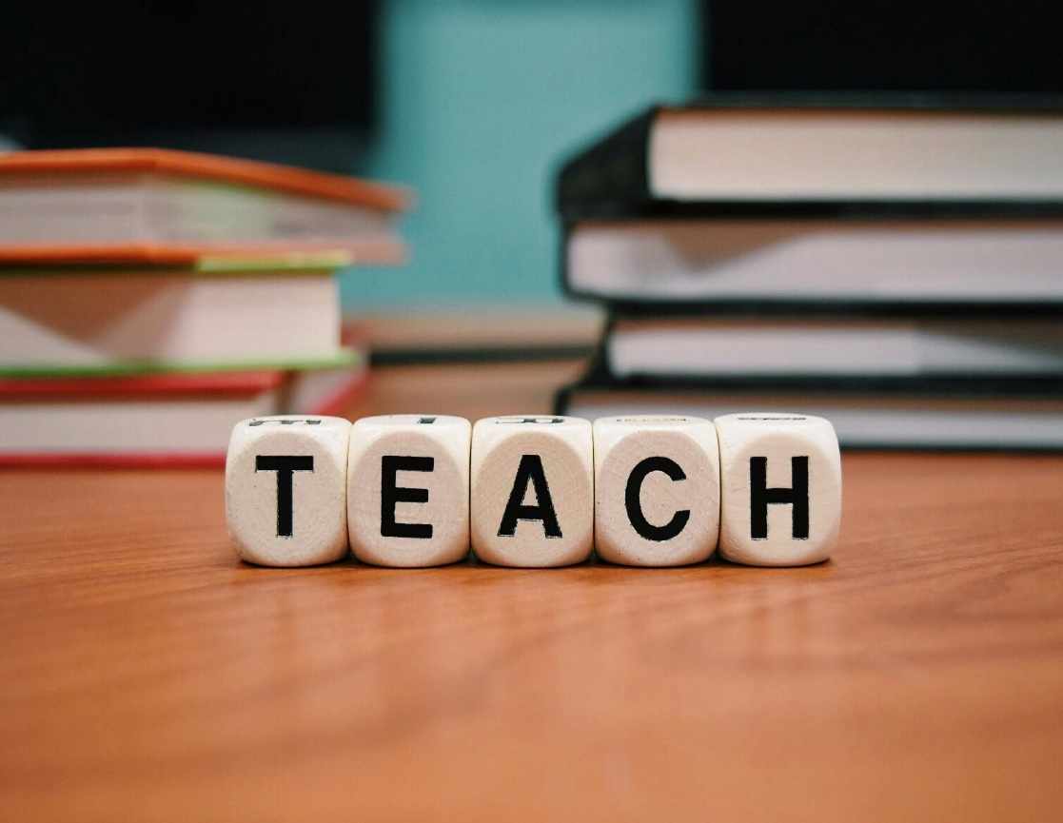
On a personal
A Personal level, education opens doors to career opportunities and promotes financial stability. It also fosters creativity and helps shape values, enabling individuals to become responsible citizens.

Slide 4
Societally
Education drives progress by encouraging civic engagement and reducing inequality. An educated population is better equipped to address global challenges like climate change and poverty, fostering innovation and collaboration.

Slide 5
Moreover
Education promotes cultural understanding, helping to build a more inclusive and peaceful society.

Slide 6
Thankyou
Created by Mudassir Nasir

